Slide 1

Challenge 8:- Provide Insights to the Product Strategy Team in the Banking Domain
Presented By :- David John

Slide 2

Introduction
Mitron Bank is a legacy financial institution headquartered in Hyderabad.
They want to introduce a new line of credit cards, aiming to broaden its product offerings and reach in the financial market
Presented By :- David John

Slide 3

AtliQ Data Services operates across various domains.
They decided to explore the banking sector and obtained an internal link. Subsequently, they approached Mitron Bank with a proposal to implement a project.
The Strategy Director of Mitron Bank, Mr. Bashnir Rover, expressed skepticism and requested a sample project involving 4000 customer details before committing to the full project.
Presented By :- David John

Slide 4
The Provide a 4000 customer Information.
They give Two Excel File
1)dim_customers
2) fact_spends
dim_customer information:-
A)Customer_id :- In this coloumn unique recorded id is present.
B)Gender :- Have the two-value male, female.
C)Age_group :- In this column categorizes the customer into different age groups. (21-24, 25-34, 35-45, 45+)
D)Marital_status:-This column indicates the marital status of the customer (single, married)
E)City:-This column represents the city of residence for the customer. (Mumbai, Delhi-NCR, Chennai, Hyderabad, Bengaluru).
F) occupation: This column denotes the occupation or profession of the customer. (Salaried IT Employees, Salaried Other Employees, Business Owners, Freelancers, Government Employees)
G)Average_Income: This column indicates the monthly average income of the customer, in INR currency.
Fact_spends information:-
customer_id: This column represents the Unique ID of each customer, linking to the dim_customer table.
month: This column indicates the month in which the spending was recorded. (May, June, July, August, September, October)
category: This column describes the category of spending (Entertainment, Apparel, Electronics, etc).
payment_type: This column specifies the type of payment used by the customer (Debit Card, Credit Card, UPI, Net Banking).
spends: This column shows the total amount spent by the customer in the specified month, category and payment_type.
Presented By :- David John

Slide 5

Presented By :- David John

Slide 6
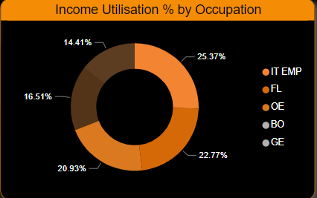

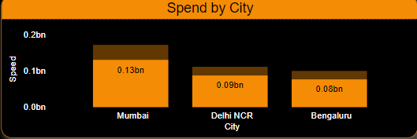
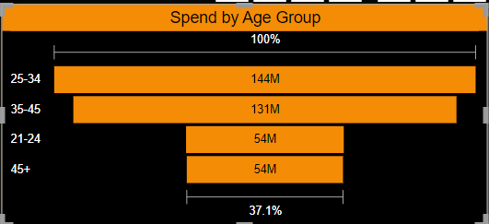
Top 3 Occupation
It Employee(IT employee),freelancer (FL) ,Other Employee (OE) they Income Utilisation % is 287.05 %.
Top 3 City
1)Mumbai 0.13 bn,
2)Delhi 0.09bn,
3)Bengulare 0.08bn
Top 2 Age Group
1) The 25 to 34 age Group Shows 144 M
2) The 35 to 45 age Group Shows 131 M
Presented By :- David John

Slide 7
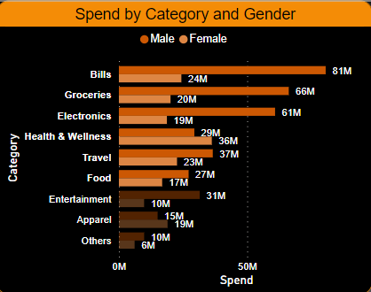
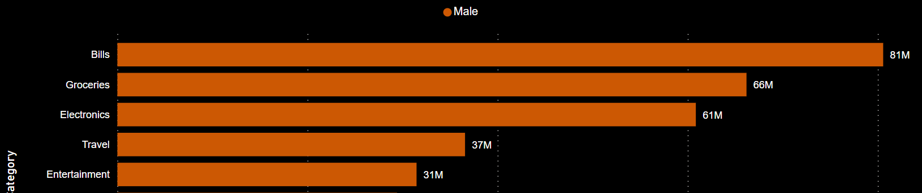
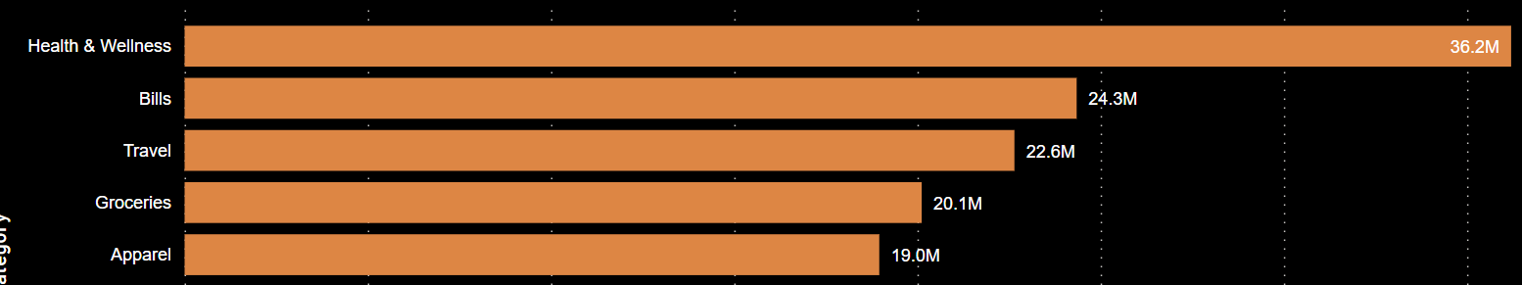
Category Wise
Bills,Groceries,Electronics,Health & Wellness, travel, Food this category
Gender Wise
Male was Spending in Bills ,Groceries,Electronics,travel,
Entertainment
Gender Wise
Female was Spending in Health & Wellness,Bills,Travel,
Groceries,Apparel
Presented By :- David John

Slide 8
Conclusion
Male are Spending 266.34 % income utilization.
If we offer discounts on groceries, bills, and online payments, there is a chance that 20% more people will use a credit card for these purchases.
Female Are Spending 239.55% income utilization.
If we offer incentives or discounts on health and wellness, groceries, and travel, there's a 15% chance that individuals will opt to use credit for purchases in these categories.
Both married and single individuals tend to spend the most in these three categories: We should offer incentives or discounts on electronics, groceries, and dining/food.
The age 25-34 ,35-45 this two age group are spending in groceries,Bills, electronics.

